Slide 1
Research on Creating RevoU Mobile App
Muhamad Rayhand Prasetya

Slide 2
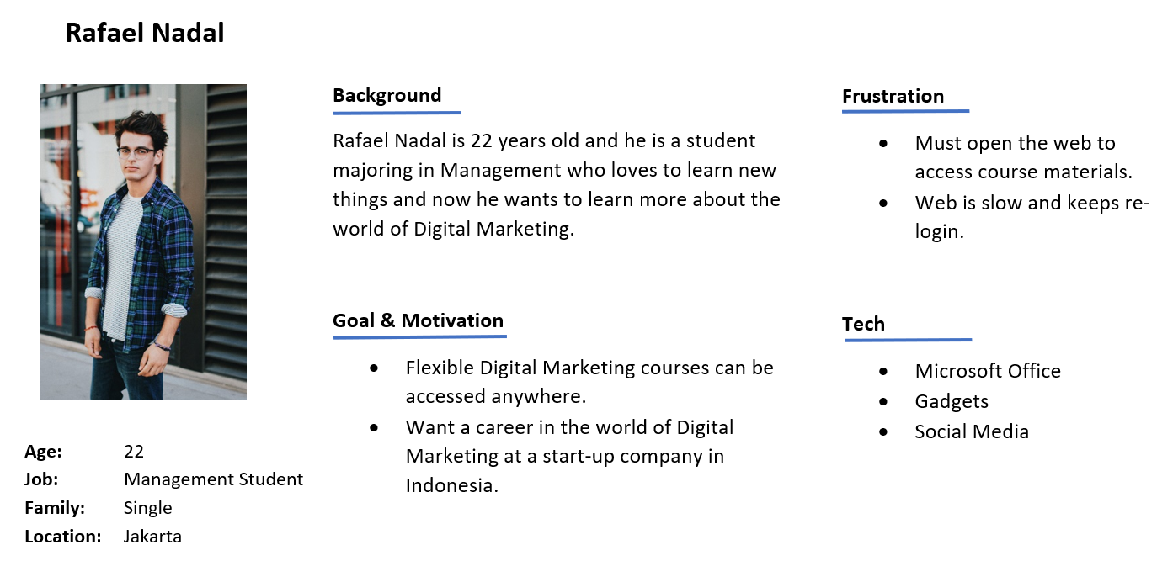

Slide 3

User Journey Map
Stages
Research
Browse
Setup
Use
Review
Flexible courses can be accessed on many platform
Get to know the website of the course
Easy to setup account
Easy to use
Rate and feedback
Customer Goals
Find some best courses in any platform
Go to the website
Fill registration form
Try some needed features
Write feedback in course web
Process

Slide 4
User Journey Map
Stages
Research
Browse
Setup
Use
Review
Receive confirmation that they have successfully booked a class and saved a spot
Compare different offers across other platforms that offer workshops, training, or certifications
A lot of benefit features
Receive information about potential workshops or webinars that could help him to shift his career.
Web Smooth or Not lag
Didn’t face any problem in the web
Get information about best courses app with great feature and user friendly
Book a class that he wants according to the skills that he needs
Simple account setup
Expectation
😐
🙂
😁
😆
🤔
Experience
Okay
Happy
Satisfied
Curious
Hmm
Channels
Instagram
Tiktok
Google
Course Website
Course Website
Course Website
Course Website
Touch Points
Instagram Feed
Instagram Story
TikTok home
Some reputation website about courses
Homepage
Registration or Login page
Main page in Web
Dashboard
Web feedback corm

Slide 5
User Journey Map
Stages
Search
Browse
Setup
Use
Review
Some links are dead when it’s supposed to direct to the play store/app store
Not flexible because you have to browse on Google first
Need to login every time get into the web
UI of app is a bit confusing
There is no option to ask the Lecturer and Customer Service in a live chat/call
Pain Point
Renew the link that directs user to play store/ app store
Thinking about new platform that accessible anywhere
Make a one-time login option
Revamp the UI
Provide in-app live chat/call for user to ask to Customer Service and Teacher
Possible Solution

Slide 6
Problem Statement
User has to browse on Google first before get into the course website.
User has no option to contact Customer Service and asking Lecturer in live chat/call.
User feels that the UI is confusing and need a better one that is easy to understand.

Slide 7
Research Purpose/Objectives
Create a mobile application for courses with an attractive User Interface and available live chat/call features for student to ask teachers and customer service.
Application that is made can help students learn RevoU course material flexibly with full features and live interaction and students can also monitor the courses that they taken.
OKR #1: Increase the number of students from 25% to 50%
OKR #2: Increase the active students that complete the course in app from 30% to 60%

Slide 8
Research Methodology
Quantitative
Method: Survey
Study:
User behaviour in using courses platform based on their experience
Their pain points that they face during using the course platform
What features that they need to support their study in the platform

Slide 9
Sample Size & Target Respondent
Target Size:
25 respondents
Target Respondents:
Male or Female age 17 - 25
From any city in Indonesia with available internet connection
Active student/Fresh graduate
Type of live teaching online learning

Slide 10
Research Question
Do you think it’s enough with the features that provided by online courses in the current situation?
What other features do you think would be beneficial for students to support their learning process?

Slide 11
Timeline
Kick off: 9 Juli 2022
Research: 12 Juli - 18 Juli 2022
Report: 24 Juli 2022

Slide 12
Deliverables
Provide Live chat/call feature because that is one of the important feature that users need.
More attractive UI of platform is important for user, it facilitates interactions between the user and platform.
Users prefer flexible platform to use without having to browse on internet first.

Slide 13
Thank you

